Slide 1
BASIS DATA
CHARACTER
FUNCTIONS
Eka Wahyudi
Politeknik Negeri Ketapang
2021

Slide 2
[
]
SCALAR/CHARACTER FUNCTIONS
UCASE( ) - upper case
LCASE( ) - lower case
MID( ) – mengambil bagian dari char
LENGTH( ) – panjang char
ROUND( ) – Membulatkan bil bulat
NOW( ) - current system date and time
CURDATE( ) - current system date
CURTIME( ) - current system time
Eka Wahyudi, Politeknik Negeri Ketapang, 2016

Slide 3
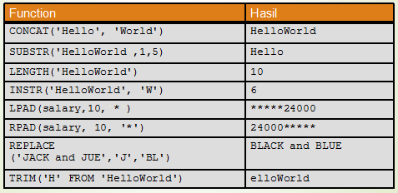
[
]
SCALAR/CHARACTER FUNCTIONS
Eka Wahyudi, Politeknik Negeri Ketapang, 2016

Slide 4
[
]
SCALAR FUNCTIONS - UCASE( )
SELECT UCASE(column_name) FROM table_name
SELECT UCASE (nama_dosen) as NamaDosen FROM dosen;
Eka Wahyudi, Politeknik Negeri Ketapang, 2016

Slide 5
[
]
LCASE( )
SELECT LCASE(column_name) FROM table_name
SELECT LCASE (nama_dosen) as NamaDosen, alamat FROM dosen;
Eka Wahyudi, Politeknik Negeri Ketapang, 2016

Slide 6
[
]
MID( )
SELECT MID(column_name,start[,length]) FROM table_name
SELECT MID(alamat,1,4) as SmallAlamat FROM dosen;
Eka Wahyudi, Politeknik Negeri Ketapang, 2016

Slide 7
[
]
LENGTH( )
SELECT LENGTH(column_name) FROM table_name
SELECT LENGTH(alamat) as LengthOfAlamat FROM dosen;
Eka Wahyudi, Politeknik Negeri Ketapang, 2016

Slide 8
[
]
ROUND( )
SELECT ROUND(column_name,decimals) FROM table_name
SELECT kode_mahasiswa, kode_matakuliah, ROUND(angka,0) as Nilai FROM nilai;
SELECT kode_mahasiswa, kode_matakuliah, ROUND(angka,1) as Nilai FROM nilai;
Eka Wahyudi, Politeknik Negeri Ketapang, 2016

Slide 9
[
]
NOW( )
SELECT NOW() FROM table_name
SELECT nama_dosen, alamat, Now() as PerDate FROM dosen;
Eka Wahyudi, Politeknik Negeri Ketapang, 2016

Slide 10
[
]
CURDATE( ), CURTIME( )
SELECT NOW(),CURDATE(),CURTIME()
Eka Wahyudi, Politeknik Negeri Ketapang, 2016

Slide 11


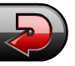
SEKIAN
TERIMA KASIH
Notes:
FISIKA '05 KETAPANG

